Slide 1
Teaching the Ethics of Genetic Choice
Joe Givvin
E-mail: jgivvin@mtmercy.edu

Slide 2
DETERMINING MY ETHICAL POSITION
GATTICA
Questioning GATTICA
4. Problem Case
Babies by Design
Wrap-up

Slide 3
Is the 1997 film Gattaca’s overwhelmingly negative view of PGD actually justified? Or is it just another example of a serious subject distorted by celluloid sensationalism?

Slide 4
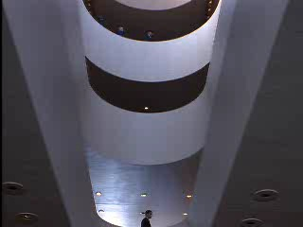

Slide 7
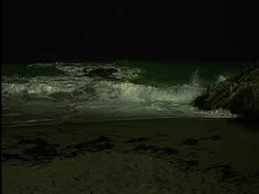

Slide 8
Eugenics
Derived from the Greek word for “well-born.”
PLATO’S REPUBLIC

Slide 9
Modern eugenics
Darwin’s theory of evolution: species change as a result of natural selection. The “fit” survive and the “unfit” do not.
Animal breeders and flower fanciers were able to obtain breeds of animals and plants that were strong in certain chosen characteristics through artificial selection.

Slide 10
Modern eugenics
Mainstream movement.
Emphasis on the shaping of public policy with the aid of scientific experts (reform eugenicists in progressive movement.)
Not just “them” (Nazis). There were eugenics movements in England, France and the United States.

Slide 11
Francis Galton: the science of improving the human condition through “judicious matings...to give the more suitable races or strains of blood a better chance of prevailing speedily over the less suitable.”

Slide 12
Sterilization
By 1930, 27 states with sterilization laws.
Wholesale sterilization of “poor at the margins of society.”
Some states competed to sterilize the most & boasted of how much money they were saving.

Slide 13
Nazi eugenics
Hitler comes to power in 1933 and Nazi party passes laws to promote eugenics.
More than 400,000 people are sterilized because of feeblemindedness, schizophrenia, manic-depression, epilepsy, Huntington disease, genetic blindness...and severe alcoholism.

Slide 14
Babies by Design
Ron Green’s “aim in the book is to challenge the negative views that underlie works like… Gattica.” page 7
“…we should begin considering deliberate intervention in our own and children’s genetic makeup-to both prevent disease and enhance human life.” page 5

Slide 15
Evil eugenics of the past
“…use of state power and coercion to enforce eugenic ideals.”
“…harebrained science…traced undesirable social phenomenon…to singe inheritable factors…”
“…elitist and often racist assumptions…” pages160-161

Slide 16
How can we avoid errors of the past?

Slide 17
Green’s solution
His principle-
PARENTAL LOVE ALMOST ALWAYS PREVAILS
“Parents will try to produce the children they desire, but in almost all cases they will love the children they get no matter what qualities they possess.” page 116

